Slide 1
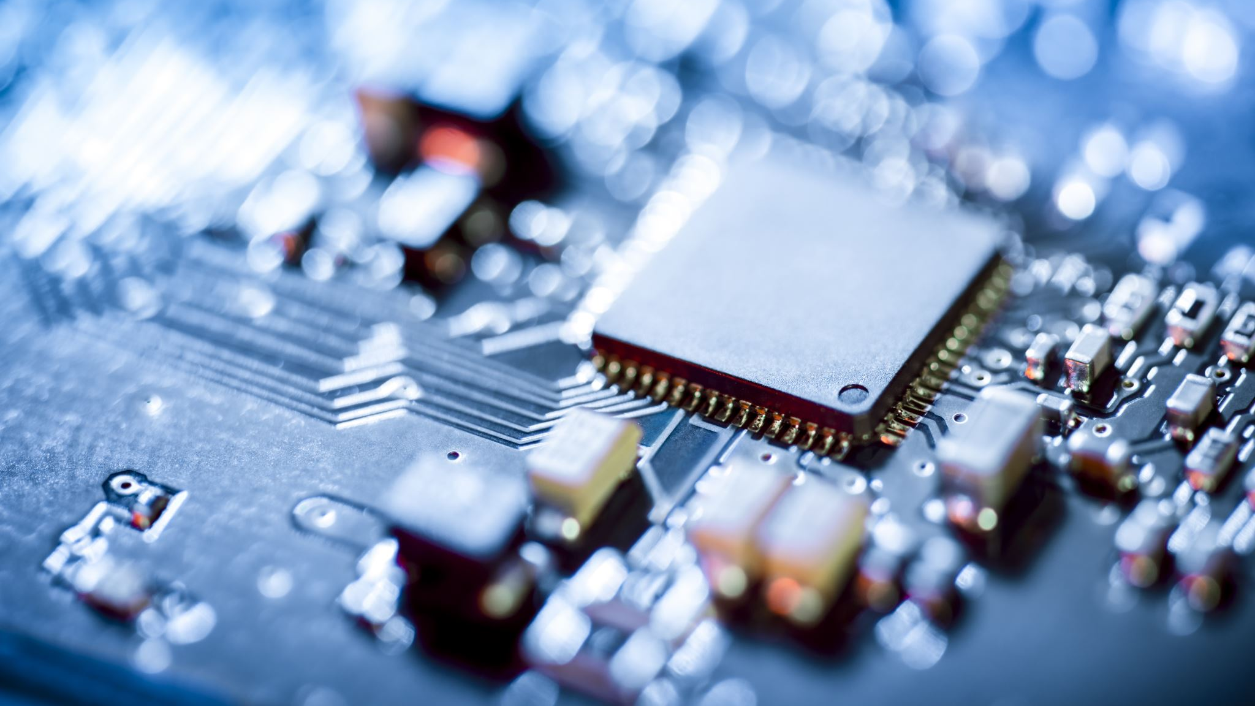
Electric Field of a Parallel Capacitor
Thevexis

Slide 2


Solving Partial Differential Equations
Classical electrodynamics says electric potential from static charges satisfies Poisson’s PDE:
Charge free regions of space gives Laplace's Equation:

Slide 3
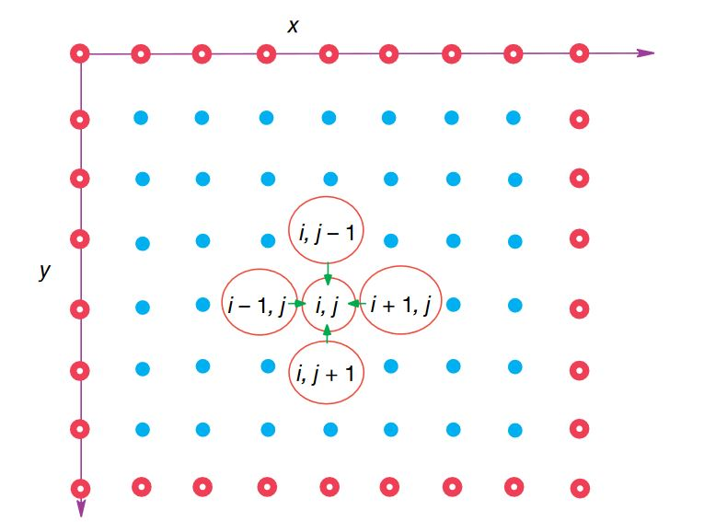
Finite Difference Algorithm

Slide 4

THE Goal
Electric field around two capacitor plates at 100V and -100 Volts
A dielectric material between the two plates
Plates have a thickness

Slide 5

The COde

